Slide 1
PX4 Hawk Position Estimator

Slide 2
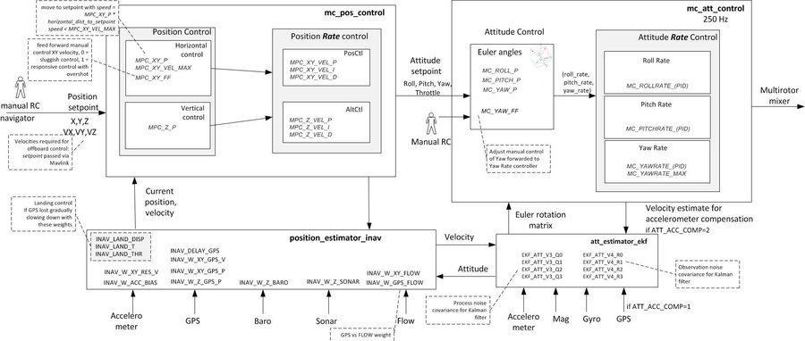
Multirotor Flight Control

Slide 3
Position_estimator_inav
Position estimator inav app is position estimator, based on inertial model, optimized for multirotors. It reads multiple sensors and estimate 3D position and velocity, in local and global frames. It can be used with position control apps, e.g. multirotor_pos_control.

Slide 4
Basic structure
int position_estimator_inav_main(int argc, char *argv[])
start
stop
status
int position_estimator_inav_thread_main(int argc, char *argv[]) // thread 로 동작

Slide 5
Data Source
The following sources (with corresponding parameters for weight) are available for altitude
Accelerometer- acceleration (W_ALT_ACC)
Barometer- Absolute altitude (W_ALT_BARO)
Sonar- relative altitude (W_ALT_SONAR)
The following sources (with corresponding parameters for weight) are available for position
Accelerometer (W_POS_ACC)
GPS Position (W_POS_GPS_P)
GPS Velocity (W_POS_GPS_V)
Optical Flow (W_POS_FLOW) NOT IMPLEMENTED YET

Slide 6
Data Output
Local Position
X,Y,Z
Velocity of X,Y and Z
Eph //error horizontal
Epv //error vertical
Global Position (Earth Coordination)
Latitude
Longitude
Altitude
Velocity of NED
Eph
Epv

